Slide 1





Lesson 4:
Ghostbuster

Slide 2
Slide

Slide 3
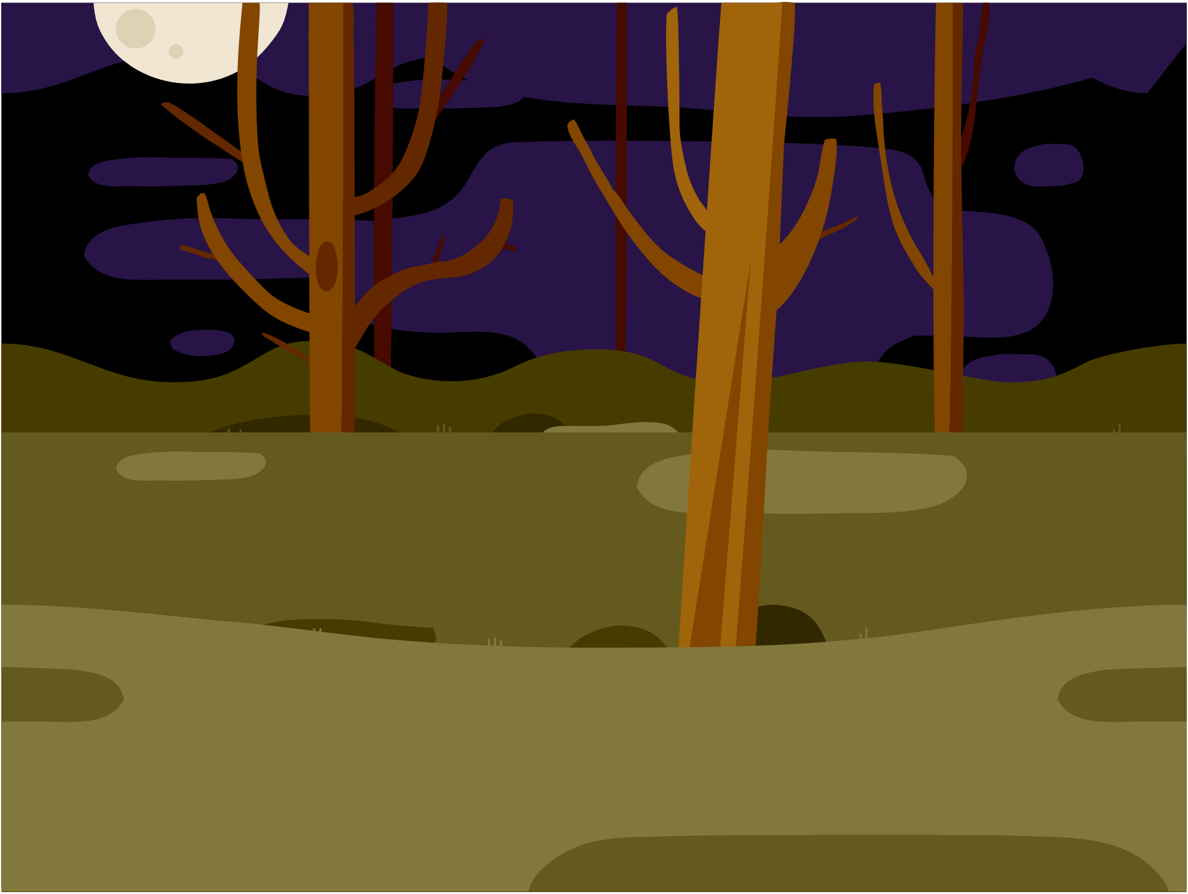
Backdrop - Woods

Slide 4


Sprites
Ghost
Magicwand

Slide 5


Change Ghost Size
OR
Manually
Code Block

Slide 6
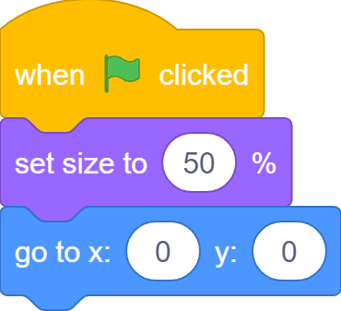
Change Ghost Size
100%
50%

Slide 7


Click to Hide Ghost

Slide 8
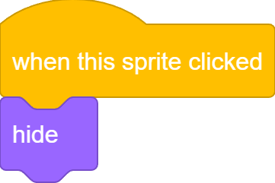

Click to Hide Ghost

Slide 9

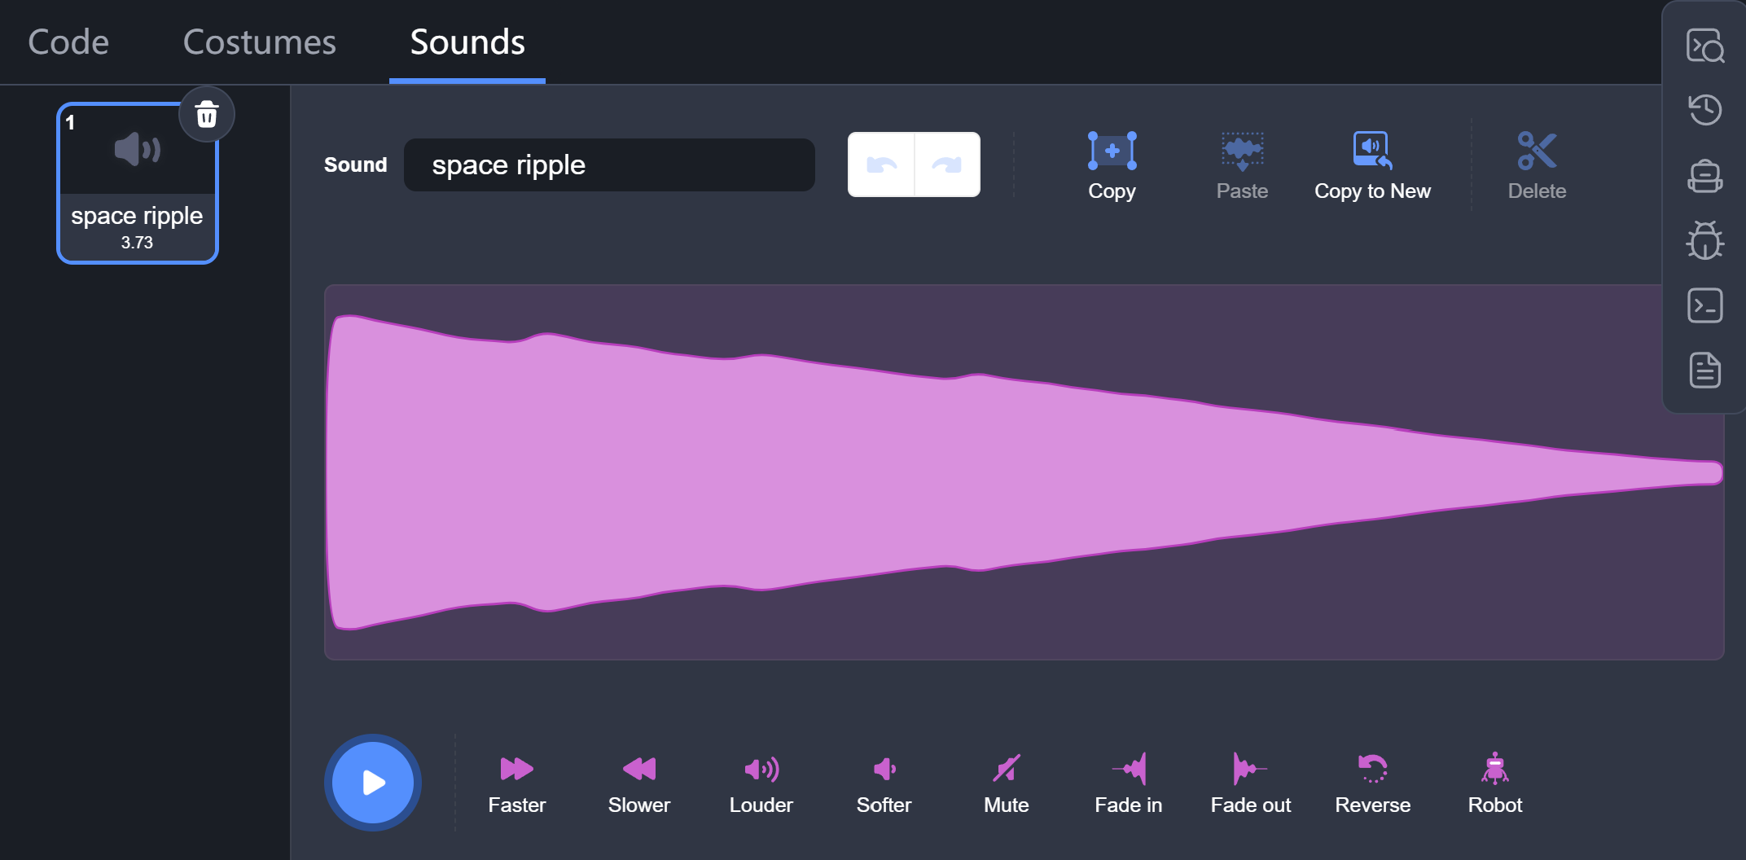
“POP”

Slide 10
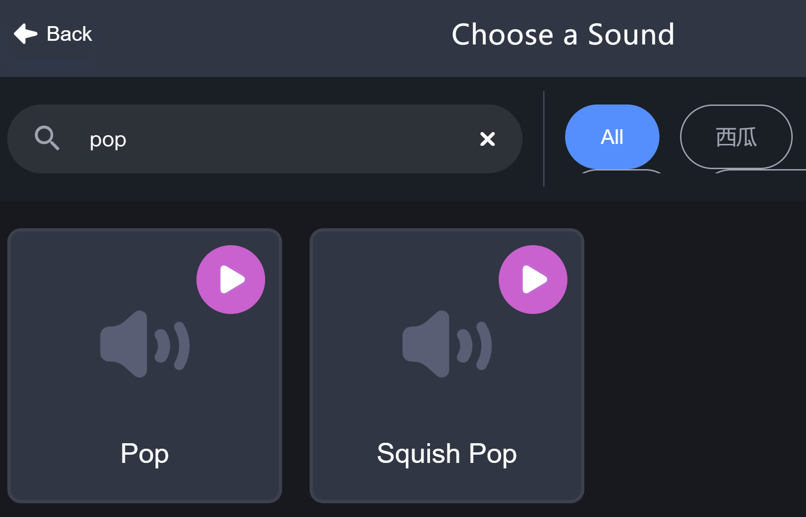
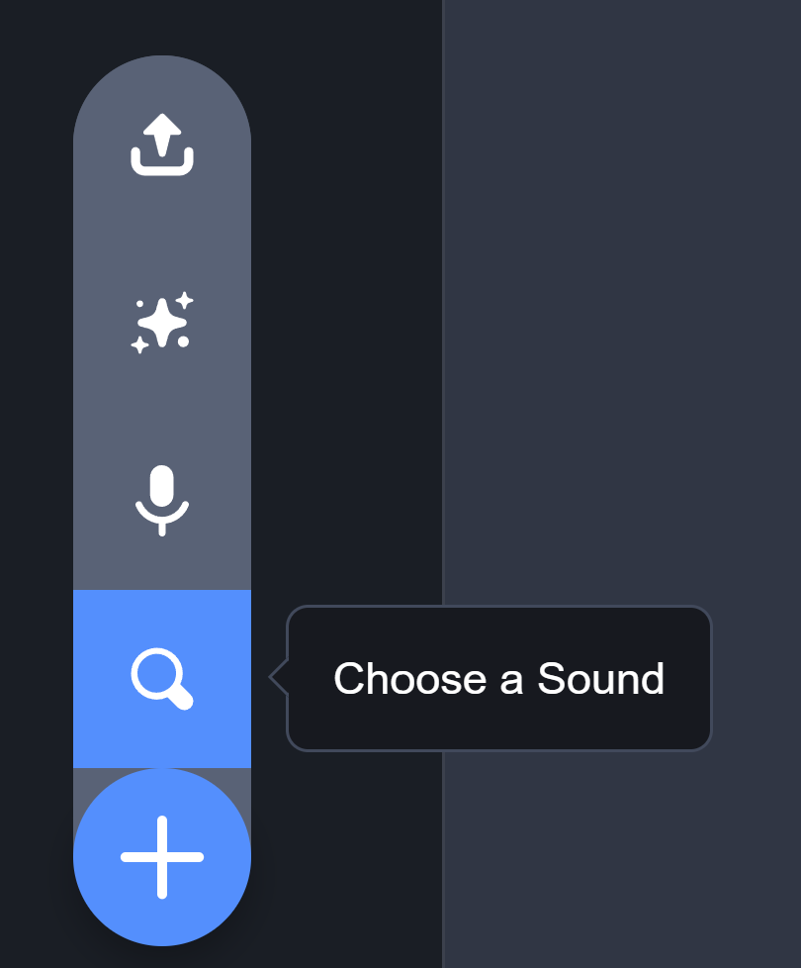
“POP”

Slide 11

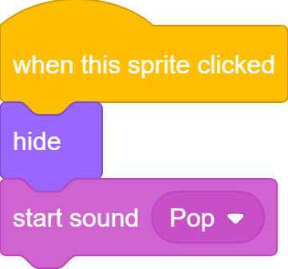
“POP”

Slide 12
What we learnt…
How to show and hide a sprite…

Slide 13
Exercises
Can you find more “loop” examples in real life?
What would happen if you repeat 0 times? A negative number of times?
Can you make a sprite rotate like the second hand of a clock, meaning it ticks each second, and finishes one full circle after 60 seconds?
Add more sprites to catch the bus!

Slide 14
Thank you and see you in the next lesson!

